Slide 1
STEPS TO TRANSLATE EDGEGALLERY DOCS
Janani B
00295757

Slide 2
Goals
Set up a python3.5 virtualenv to install tools needed for generating .pot and .po files
Generate chinese-html, .pot files(a simple skeleton structure), .po files (skeleton for different languages like en, it, fr)
Auto translate the .po files from Chinese to English
Manual translation
Build english-html for verification
Push the code

Slide 3
STEP 1: Virtualenv for Python 3.5
Check the python version in terminal: python3 -V
If the version is not 3.5, install python 3.5 in the terminal.
sudo add-apt-repository --yes ppa:fkrull/deadsnakes
sudo apt-get update
sudo apt-get install --yes python3.5 python3.5-dev
Switch the current version of python to 3.5
Locate where python3.5 is installed. It should be in /usr/bin : ls /usr/bin/python3.5
Add python3.5 into list: sudo update-alternatives --install /usr/bin/python3 python3 /usr/bin/python3.5 1
Select the number 1 executing this command: sudo update-alternatives --config python3
Check python version: python3 --version (Must be Python 3.5.x)
Make sure to link python3 with python3.5:
rm /usr//pytbinhon3
ln -s /usr/bin/python3.5 /usr/bin/python3

Slide 4
..contd
4) Once installed, pip for the same.
curl -O https://bootstrap.pypa.io/3.5/get-pip.py
python get-pip.py
python -m pip install --upgrade "pip < 21.0"
pip3 --version (Must be 20.3.4 )
5) Now create virtual env using the installed 3.5
apt-get update
apt-get install python-virtualenv
Mkdir /opt/python/3.5
virtualenv -p /usr/bin/python3 /opt/python/3.5
source /opt/python/3.5/bin/activate
Repeat step 4 to install pip3 inside the virtualenv

Slide 5
Tools to install inside virtualenv
Make sure to switch into python3.5 virtualenv.
source /opt/python/3.5/bin/activate
Fork and clone https://gitee.com/janani/docs.git in any folder.
(3.5)root1@Janani:/opt/APP_STORE/translation/test$ git clone https://gitee.com/janani/docs.git
Install the below tools
pip install sphinx
pip install recommonmark
pip install sphinx_markdown_tables
pip install sphinx_rtd_theme

Slide 6
Creating chinese_html, .pot skeleton & .po en skeleton
Create chinese_html in docs/build/html/
cd docs/
pip install -r requirements.txt
make html
Create .pot files w.r.t changes made in chinese documentation in docs/_build/gettext/
sphinx-build -b gettext . _build/gettext
Update .po files of english language from the .pot file generation in docs/locale/en/
sphinx-intl update -p _build/gettext -l en --line-width=50000

Slide 7
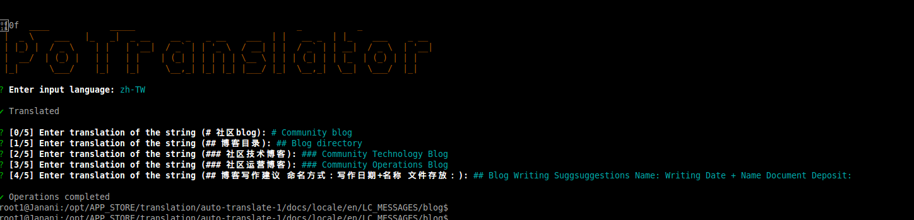
**Auto-translation of generated .po files (Skip this step)
npm install -g potranslator
Auto translate every single new .po file using this command: potranslator -p index.po -l en
Choose the input language as : zh-TW

Slide 8
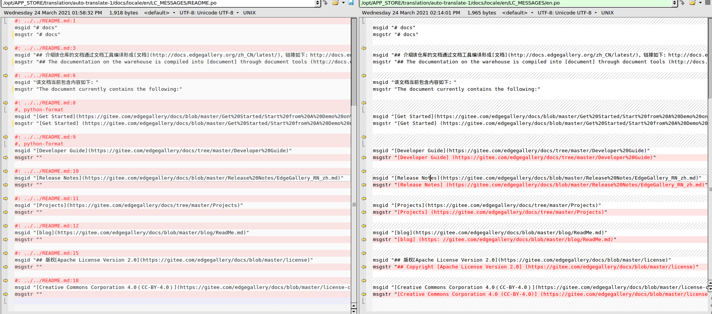
**...contd
Keep pressing enter for auto-translation to complete.
4) This produces an en.po file in the same folder which has the translated file.
5) So, use beyond compare to properly integrate the change with the original file.
** Auto translation is not needed for already existing translated .po file. This step is only for reference and need not be repeated for this task

Slide 9
Manual Translation
A .po file contains, msgid that carries the chinese string, and msgstr that contains auto-translated English string.
msgid "在kong添加一个consumer"
msgstr "Add a consumer in a pong"
The auto-translation feature will not be clear or user-friendly. So, manual translation verifies if the string formed is clear to read, and makes necessary changes in msgstr and save it.
msgstr "Adding consumer in kong"
Generate english-html files in _build/html/en
sphinx-build -b html -D language=en . _build/html/en
These html files could be used to verify how our .po file responds.

Slide 10
Pushing Code
Eventhough there will be multiple generated folders, such as _build, build inside docs folder, only contents inside locale folder must be committed. Ignore every folders except the /locale.
(3.5) root1@Janani:/opt/APP_STORE/translation/test/docs/locale$ git add -A en/
git commit -m "Auto translation into english for all projects"
git push

Slide 11
Modules for translation
Modules | Owner | Status
Projects/APPSTORE
Projects/ATP
Projects/crane-framework
Projects/Developer
Projects/MECM
Projects/MEP
Projects/UserManagement
Architecture, Blog, Developer Guide, Get Started, Projects/Port Matrix
Models, Release Notes, Resource and Repositories,

